Slide 1
Creepy Creatures

Slide 2
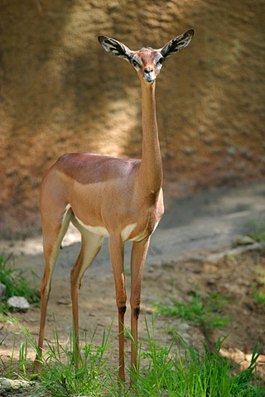
Gerenuk
East Africa
Tiny, tiny, tiny head
Long, long, long neck
Endangered

Slide 3
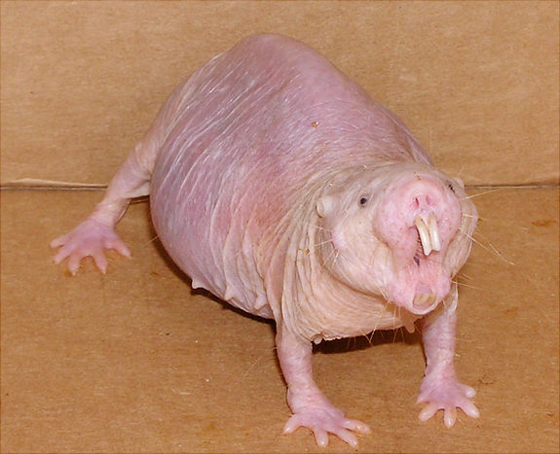
Naked Mole Rat
Asia, Egypt, S. Africa
No fur
Can’t feel pain
No eyes
Wrinkley

Slide 4
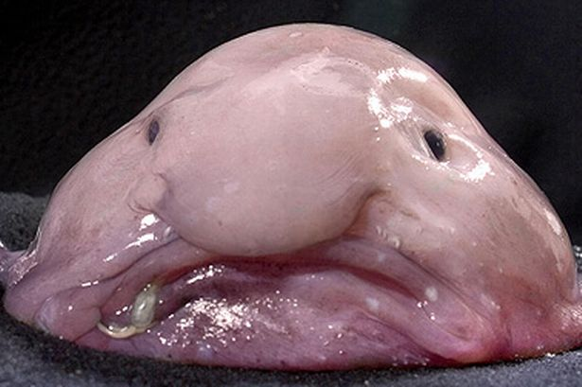
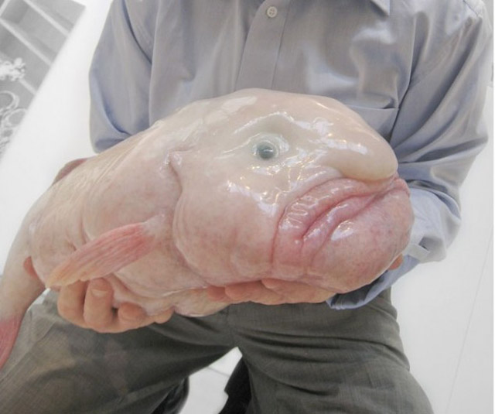
Blobfish
Australia, Tasmania, New Zealand
Blob looking
Endangered

Slide 5
Box Jellyfish
Caribbean
24 Eyes
Venom
Long tenticles

Slide 6
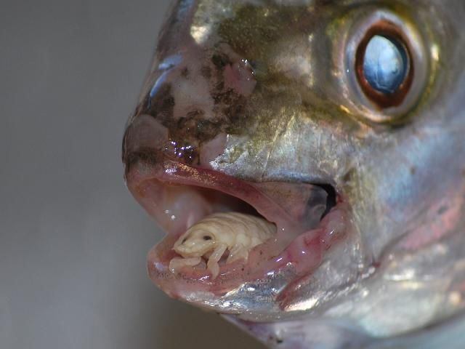
Tongue Eating Parasite

Slide 7
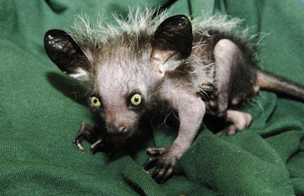
Aye-Aye

Slide 8
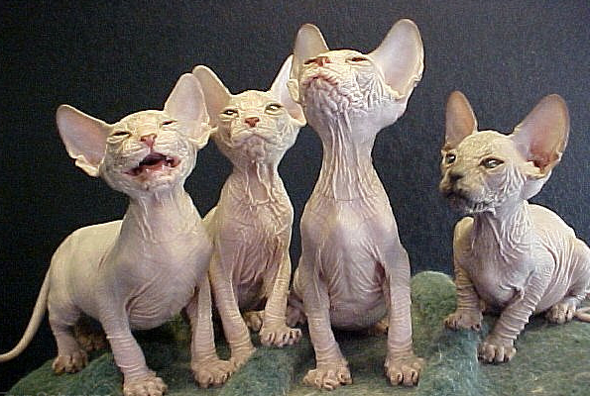
Hairless
Cat

Slide 9
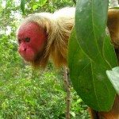
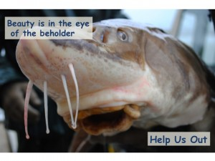
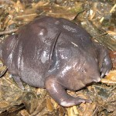
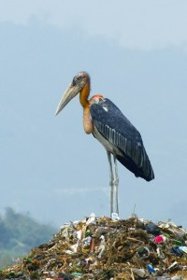
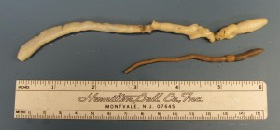
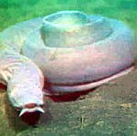
“Ugly Animal Preservation Society”
Uakari
Sturgeon
Purple pig nosed frog
Giant Palouse Earthworm
Greater adjutant
Hagfish

