Slide 1
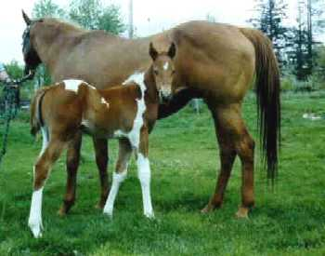
1. Horse
Parent
Offspring

Slide 2
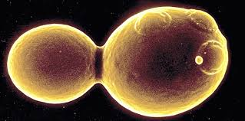
2. Yeast
Offspring Parent

Slide 3

3. Paramecium
Offspring
Parent

Slide 4
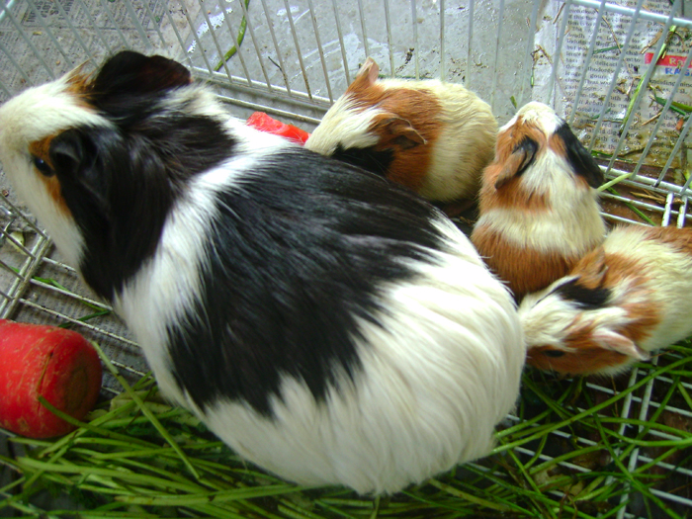
4. Guinea Pig
      Offspring
Parent

Slide 5
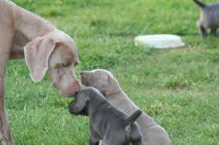
5. Dogs
Parent
Offspring

Slide 6
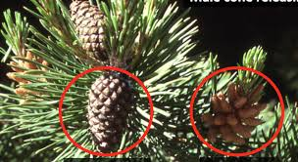
6. Evergreen Tree
Parent
Offspring

Slide 7
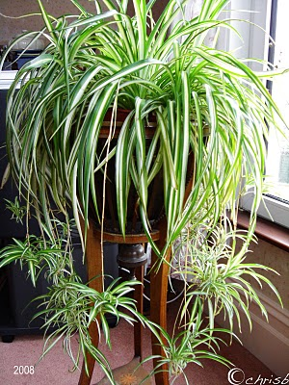
7. Spider Plant
Parent
Offspring

Slide 8
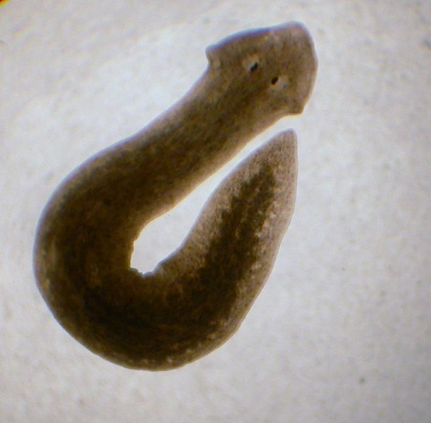
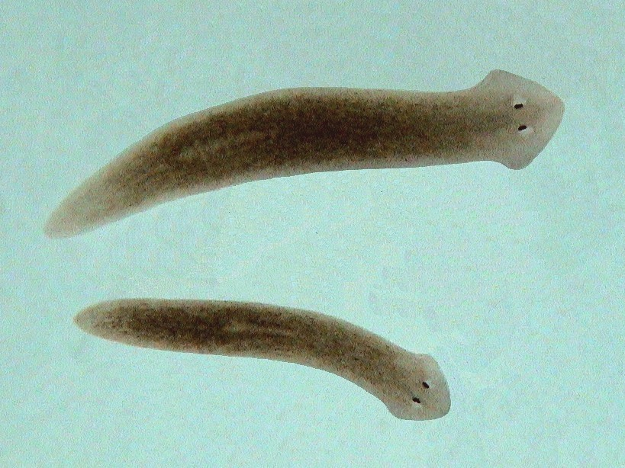
8. Planaria
2. 3. 4.
Parent Offspring

