Slide 1
Intended Learning Outcomes
For the Utah State Secondary Science Core
Grades 7-8

Slide 2
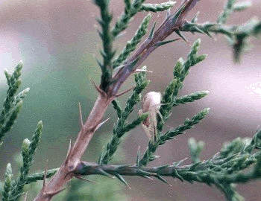
Intended Learning Outcomes (ILOs) define the generalized scientific knowledge students should learn in every science subject. They are critically important and part of every CRT question on the Core tests.
Objective:
This power point will help teachers and students understand the expectations and importance of ILOs in science instruction.

Slide 3
1. Use Science Process and Thinking Skills
Use these objects to answer the next two questions:
1. Which objects should be classified together?
A. the towel and the tennis racket because they both can be held.
B. the towel and the stuffed doll because they are both soft.
C. the diamond and the tennis racket because they both are round.
D. the diamond and the towel because they are both shiny.
a. Observe objects and events for patterns and record both qualitative and quantitative information.

Slide 4
1. Use Science Process and Thinking Skills
Use this list of characteristics to answer the next two questions:
1. can respond to the environment
2. can reproduce
3. are made of molecules
4. are made of cells
5. can move themselves
6. can grow
7. were never alive
2. Which set of characteristics describes all living things?
A. 1, 2, 4, 6
B. 2, 4, 6, 7
C. 1, 2, 3, 4, 5
D. 1, 2, 3, 4, 5, 6
b. Sort and sequence data according to a given criterion.

Slide 5
1. Use Science Process and Thinking Skills
3. Which characteristic would be used first in classifying a cow, water, a bee, a rock, and a bird?
A. mammal or non-mammal
B. backbone or no backbone
C. bird or insect
D. living or non-living
c. Develop and use categories to classify subjects studied.

Slide 6
1. Use Science Process and Thinking Skills
4. What is the mass of an object with the balance at these settings?
A. 175 g
B. 165.7 g
C. 175.8 g
D. 176.0 g
d. Select the appropriate instrument; measure, calculate, and record in metric units, length, volume, temperature and mass, to the accuracy of instruments used.

Slide 7
1. Use Science Process and Thinking Skills
An experiment with rock salt used three beakers. Each had
100 ml of water and 25 g of salt added. Beaker A was left
alone and Beakers B and C were changed. The time needed
to dissolve the salt was measured.
5. Which of the following is the best question for this experiment?
A. What happens when you place 25 grams of salt into 100 mL of water?
B. What changes the speed it takes salt to dissolve?
C. What happens to salt when it dissolves in water?
D. When does salt and water change chemically?
When given
a problem, plan
and conduct
experiments
in which they:
Form research
questions.

Slide 8
1. Use Science Process and Thinking Skills
Students added vinegar to baking soda and
collected the gas. They timed how much gas formed
in 30 seconds to measure the speed of the reaction.
Each test was repeated 4 times.
6. Which is the dependent variable?
A. baking soda
B. vinegar
C. conditions
D. amount of gas
When given
a problem,
plan and
conduct
experiments
in which
they:
Identify
variables.

Slide 9
1. Use Science Process and Thinking Skills
Reactions Involving Atmospheric Oxygen
7. How is rusting different from the other three reactions?
A. It happens in the out-of-doors.
B. It uses water.
C. It involves metal atoms.
D. It cannot be measured.
e. When given a problem, plan and conduct experiments in which they:
Discuss possible outcomes of investigations.

Slide 10
1. Use Science Process and Thinking Skills
8. Students collect data as they
measure temperature changes
in heated water. How should
they record the temperatures?
Data table
Line graph
Bar graph
Pie chart
e. When given a problem, plan and conduct experiments in which they:
Select appropriate format (e.g., graph, chart, diagram) to summarize data obtained.

Slide 11
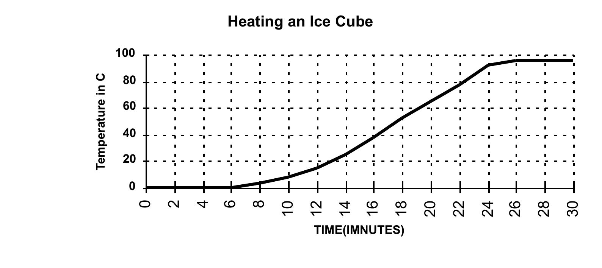
1. Use Science Process and Thinking Skills
Use the following graph to answer the next three questions. It shows the temperature of an ice cube as it is heated.
9. What should students conclude about the boiling temperature of water?
A. Water boils at 24 minutes
B. Water boils at 100° C
C. Water boils at 95° C
D. Water boils between 0-95° C
e. When given a problem, plan and conduct experiments in which they:
Analyze data and construct reasonable conclusions.

Slide 12
1. Use Science Process and Thinking Skills
10. The study of a lake study shows that an incoming stream deposits larger particles as it enters the lake and smaller ones in the center of the lake. What inference should be made from these observations?
A. The particles are being sorted by size.
B. The particles are made of different materials.
C. The particles are flowing into the lake.
D. The particles are settling out at different places.
f. Distinguish between factual statements and inferences.

Slide 13
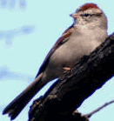
1. Use Science Process and Thinking Skills
Classification Key For Animals
1a. Organism is radially symmetrical (can be divided into equal halves in many ways)………………………………………....…Phyllum Coelentrata
1b. Organism is bilaterally symmetrical……..………...…………….Go to 2
(can be divided into half only one way)
2a. Organism has a backbone…………………….……………...……..Go to 3
2b. Organism has no backbone…………………..……… Phylum Mollusca
3a. Organism has hair or fur……………………………………Class Mammalia
3b. Organism has NO hair or fur……………………….…………………Go to 4
4a. Organism has feathers………………………………………....….Class Aves
4b. Organism has no feathers………………………………..…………...Go to 5
11. How would you classify this animal?
A. phylum mollusca
B. class mammalia
C. class aves
D. class fish
g. Use field guides or other keys to assist in the identification of subjects studied.

Slide 14
3. Demonstrate Understanding of Science Concepts and Principles
12. Why does a layer of cold air settle in valleys and warm air flow to mountain locations during Utah winters?
A. There is more warm air than cold air.
B. There is more cold air than warm air.
C. Cold air is less dense than warm air.
D. Cold air is more dense than warm air.
a. Know and explain science information specified for their grade level.

Slide 15
3. Demonstrate Understanding of Science Concepts and Principles
13. Which of the following is an example of a chemical property of water? Water
A. boils at 100 C
B. is transparent
C. has no odor
D. reacts with calcium
b. Distinguish between examples and non‑examples of concepts that have been taught.

Slide 16
3. Demonstrate Understanding of Science Concepts and Principles
14. Which of the following is a scientific concept that is most likely described with a model?
Living things are classified with a key.
Ecosystems contain plants and animals
Matter is made of atoms.
Offspring look like their parents.
c. Compare concepts and principles based upon specific criteria.

Slide 17
3. Demonstrate Understanding of Science Concepts and Principles
15. A rock dropped in a graduated cylinder raises the level of water from 20 to 35 mL. The rock has a mass of 45 g. What is the density of the rock?
A. 1.3 g/ cm³
B. 2.3 g/ cm³
C. 3.0 g cm³
D. 4.5 g/ cm³
d. Solve problems appropriate to grade level by applying scientific principles and procedures.

Slide 18
4. Communicate Effectively Using Science Language and Reasoning
16. Which data supports the inference that organisms have adapted to changing environments over time?
Organisms all look alike.
Animals and plants both need oxygen.
Fossils show different organisms lived in the past.
Environments on Earth are unchanging today.
Provide relevant data to support their inferences and conclusions.

Slide 19
4. Communicate Effectively Using Science Language and Reasoning
17. Marie Curie was the first scientist to purify and name the element Radon. What step did she need to take next to alert the scientific world?
A. Publish its chemical and physical properties in scientific journals.
B. Write a picture book to help children understand her work.
C. Tell the newspapers and have articles published about Radon.
D. Look all over the world for other samples of pure Radon.
Use precise scientific language in oral and written communication.
d. Recognize contributions to science knowledge that have been made by both men and women.

Slide 20
4. Communicate Effectively Using Science Language and Reasoning
One of the largest impacts on modern society has been the invention, development and application of new chemical products. About 50% of all chemists are involved in some way with the development or production of plastics such as Nylon, Formica, Gore-Tex, silicone, polyester, polycarbonate and PVC. Chemistry also plays a major role in materials science, from the manufacture of computer chips based on silica to paper and other wood products to structural metals such as steel and lightweight alloys of titanium and aluminum.
18. How has the development of computers depended on chemists?
A. They wrote the software to run the computer programs
B. They developed the materials in the chips, wiring and case
C. They decided which types of computers should be sold.
D. They built the first computers and created the market for them.
Use reference sources to obtain information and cite the sources.

Slide 21
4. Communicate Effectively Using Science Language and Reasoning
19. If each dot in the cube is a particle of with the same mass, which cube has the greatest density and why?
A. A, it has the fewest particles for the volume of the cube.
B. B, it has the most particles for the volume of the cube.
C. C, it has the greatest volume for the mass of the cube.
D. D, it has the most particles for the volume of the cube.
Use mathematical reasoning to communicate information.

Slide 22
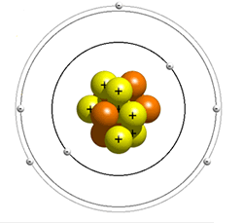
4. Communicate Effectively Using Science Language and Reasoning
20. What ways is this
drawing of an atom
accurate?
A. It has accurate colors for the parts.
B. It shows the correct distance and size of the parts.
C. It has moving parts.
D. It shows the correct parts of the atom.
f. Construct models to describe concepts and principles.

Slide 23
5. Demonstrate Awareness of Social and Historical Aspects of Science
21. Sidewalks have “cracks” which are imprinted every meter or two in the cement. What is the purpose of these cracks?
A. They have always been there.
B. The sidewalk looks better and can be more easily manufactured.
C. It makes the sidewalk easier to measure.
D. They help prevent breaking when the cement is heated.
Cite examples of how science affects life.

Slide 24
5. Demonstrate Awareness of Social and Historical Aspects of Science
22. What influenced the
development of cell theory after
the discovery of cells by Van
Leuwenhoek?
The development of the telescope.
Modifications made to the microscope.
The ability to rapidly share the information.
Discoveries about the nature of ecosystems.
Give instances of how technological advances have influenced the progress of science and how science has influenced advances in technology.

Slide 25
5. Demonstrate Awareness of Social and Historical Aspects of Science
23. What do most new discoveries in chemistry depend on?
Starting over at the beginning of the chemical age.
Building on the work done by previous scientists.
Ignoring past scientific discoveries.
Repeating older experiments.
Understand the cumulative nature of the development of science knowledge.

Slide 26
5. Demonstrate Awareness of Social and Historical Aspects of Science
24. A biologist studies photosynthesis and describes it as a biological process. A chemist studies photosynthesis and describes it as a chemical reaction. Which scientist is correct?
A. both, they use different terms but agree on the reactants and products.
B. neither, if scientists don’t agree, then conclusions cannot be made.
C. the chemist because photosynthesis has both reactants and products.
D. the biologist because it is a biological process occurring in cells.
h. Understand that various disciplines of science are interrelated and share common rules of evidence to explain phenomena in the natural world.

Slide 27
6. Demonstrate Understanding of the Nature of Science
25. Who uses scientifically
gathered evidence to solve
problems and gather knowledge?
Scientists
Many people
All people
Americans
a. Science is a way of knowing that is used by many people, not just scientists.

Slide 28
6. Demonstrate Understanding of the Nature of Science
26. How do scientists know matter is made of particles?
A. Scientists following only the “scientific method” discovered it .
B. A variety of methods have proven it.
C. People have always known it.
D. A famous scientist decided it was true.
Understand that science investigations use a variety of methods and do not always use the same set of procedures; understand that there is not just one "scientific method."

Slide 29
6. Demonstrate Understanding of the Nature of Science
27. Plant roots appear to pull nutrients out of the soil but scientists agree that plants get their “food” from the air. Why do scientists accept something that does not appear to be true?
A. They decided at a meeting after careful thought.
B. They have interviewed farmers in many places on Earth.
C. They have evidence from experiments with plant growth.
D. They found information on plant growth in books about plants.
Science findings are based upon evidence.

Slide 30
6. Demonstrate Understanding of the Nature of Science
28. Why are conclusions about plant and animal classification made by scientists 200 years ago no longer considered correct?
A. scientists can change their conclusions based on new evidence.
B. scientists in early days did not make accurate observations
C. plants and animals have changed since the early days
D. scientists no longer use classification schemes
Understand that science conclusions are tentative and therefore never final. Understandings based upon these conclusions are subject to revision in light of new evidence.

Slide 31
6. Demonstrate Understanding of the Nature of Science
29. Why are scientists confident
that dinosaur fossils of animals
with wings used them to fly?
Because it makes sense.
Because scientists know about the past.
Because they cannot think of anything else the wings are for.
Because they assume animals in the past are like those of today.
Understand that scientific conclusions are based on the assumption that natural laws operate today as they did in the past and that they will continue to do so in the future.

Slide 32
6. Demonstrate Understanding of the Nature of Science
30. A biologist and a chemist both investigate an ecosystem. How will their conclusions vary?
A. They may not agree but both will be based on evidence.
B. They will be slightly different because biologists do not use a control.
C. They will be very different because the chemists will use mathematical analysis.
D. The two scientists will disagree on the results because they use different methods.
Understand that various disciplines of science are interrelated and share common rules of evidence to explain phenomena in the natural world.

Slide 33
Key 1. B 2. A 3. D 4. C 5. B 6. D 7. C 8. A 9. C 10. A 11. C 12. D 13. D 14. C 15. C
16. C
17. A
18. B
19. D
20. D
21. D
22. B
23. B
24. A
25. B
26. B
27. C
28. A
29. D
30. A

