Slide 1
Heredity & Genetics
Traits- Characteristic, quality, or feature that distinguishes an organism
Genetics/Heredity- The passing on of traits from parent to offspring

Slide 2
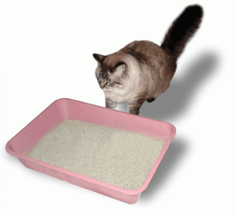
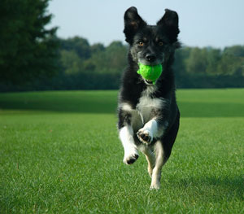
Acquired Trait- Trait that is learned or obtained through experience or practice.

Slide 3
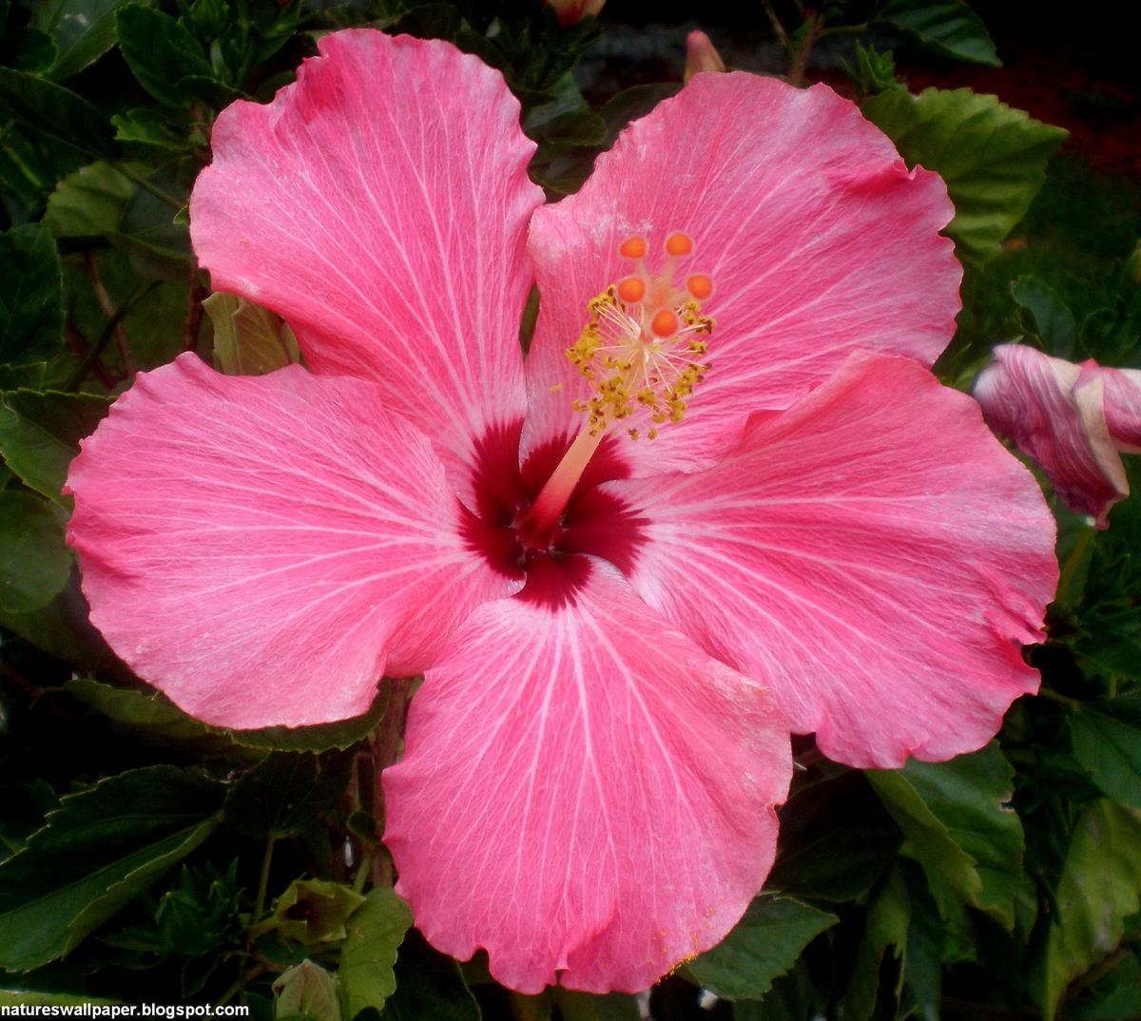
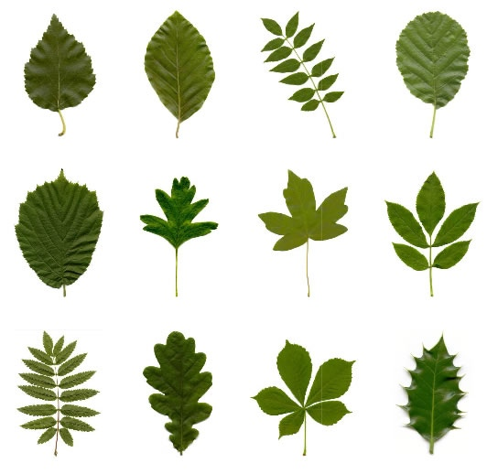
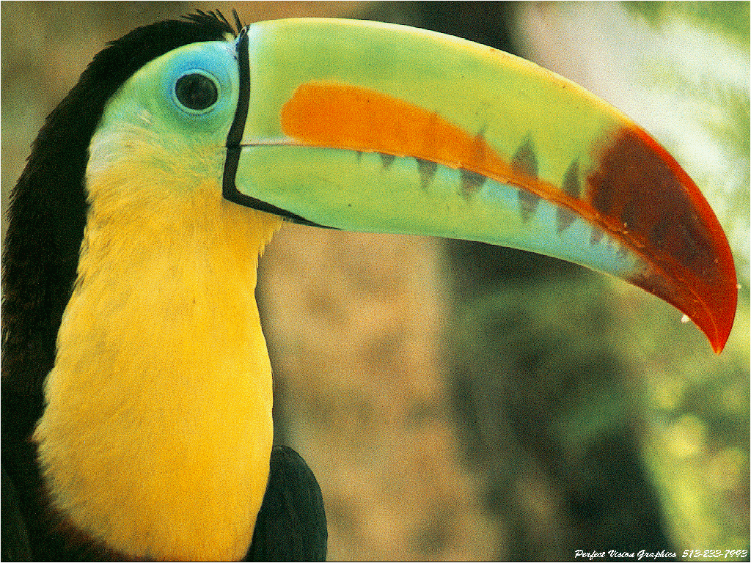
Inherited Trait- Trait that is passed from parent to offspring.

Slide 4
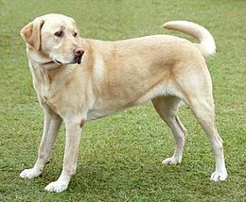
# of Legs

Slide 5
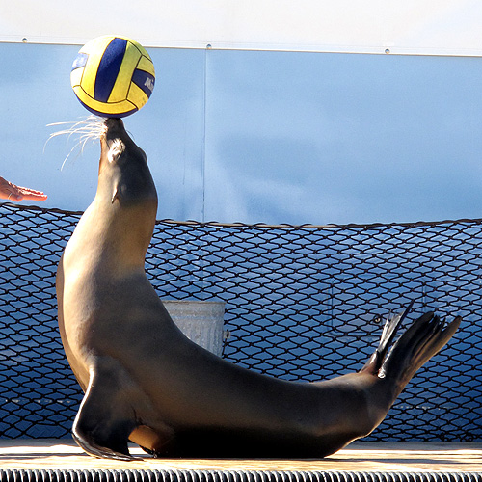
Seal Bouncing a Ball

Slide 6
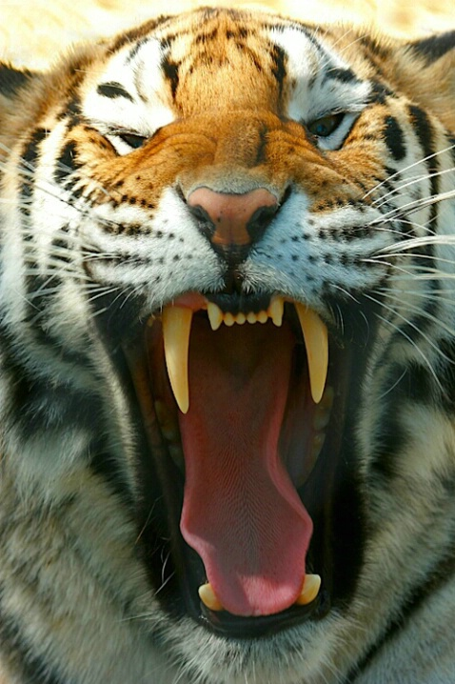
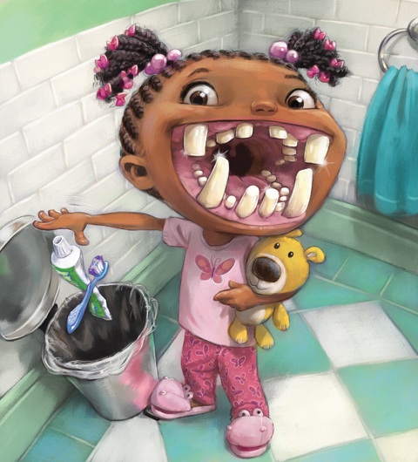
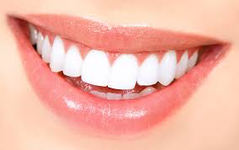
Tooth Shape

Slide 7
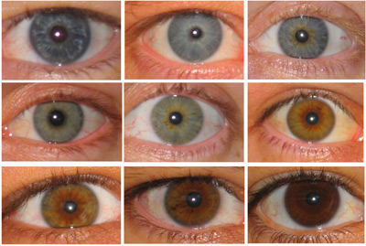
Eye Color

Slide 8
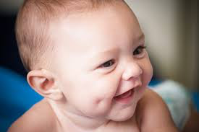
Dimples

Slide 9
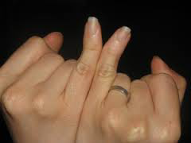
Bent Pinky Finger

Slide 10
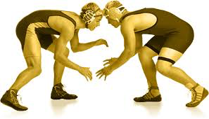
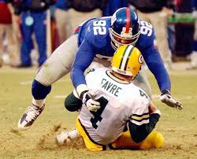
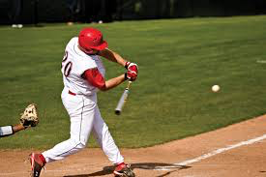
Great at Sports

Slide 11
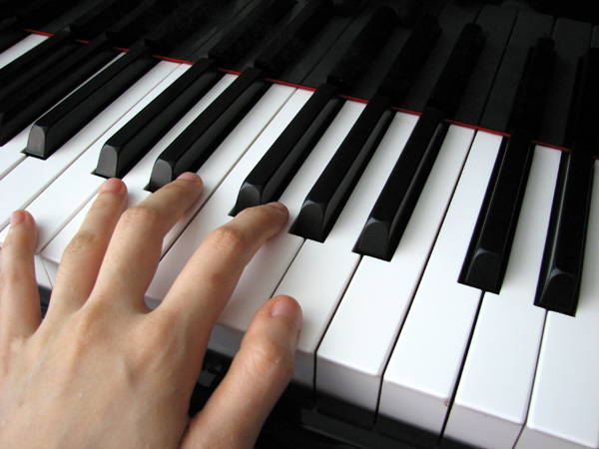
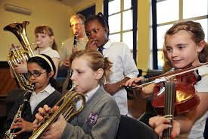
Playing an Instrument

Slide 12
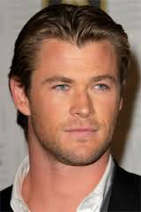
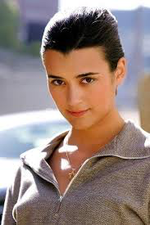
Widows Peak

Slide 13
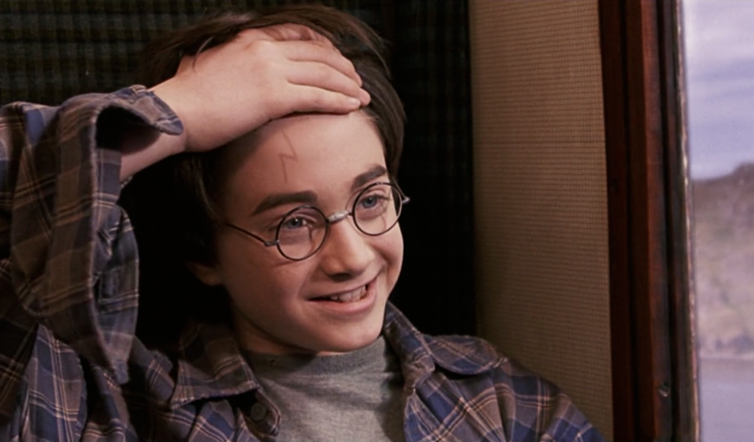
Scars on Head

Slide 14
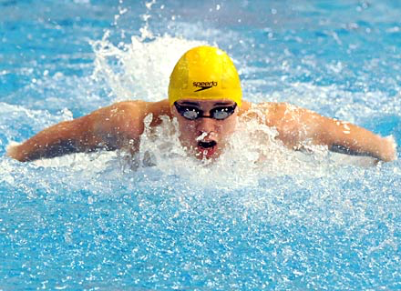
Knowing how to Swim

Slide 15
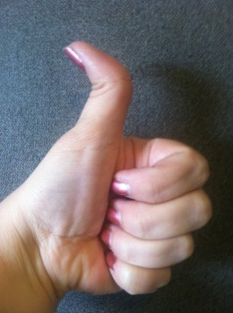
Hitchhiker’s Thumb

Slide 16
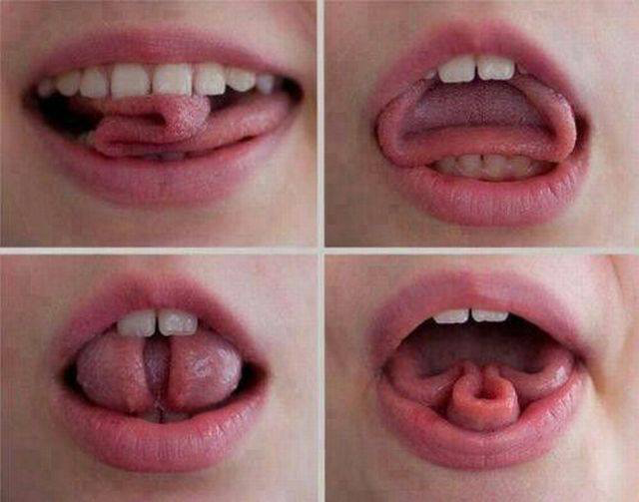
Curled Tongue

Slide 17
Great Cook

Slide 18
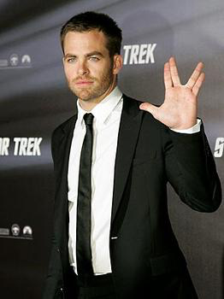
Vulcan Hand Sign

Slide 19
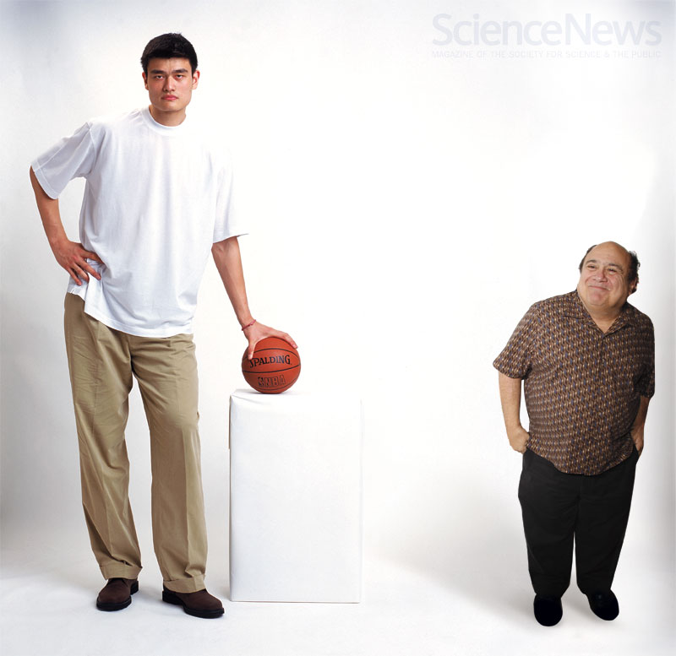
Height

Slide 20
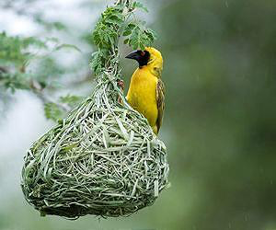
Bird Building a Nest

Slide 21
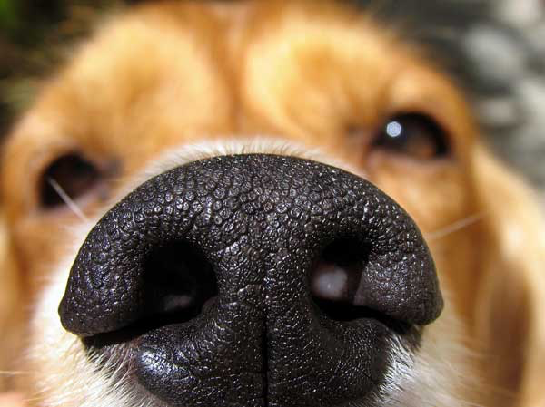
Sense of Smell

Slide 22
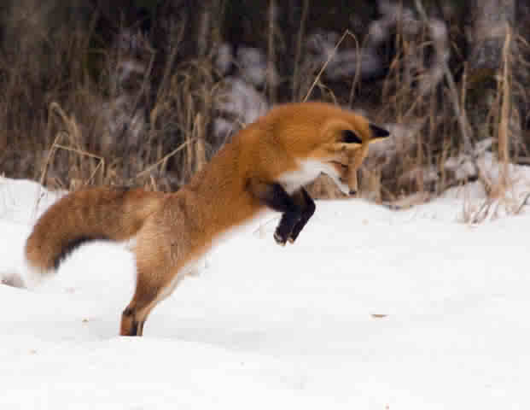
Pouncing on Prey

Slide 23
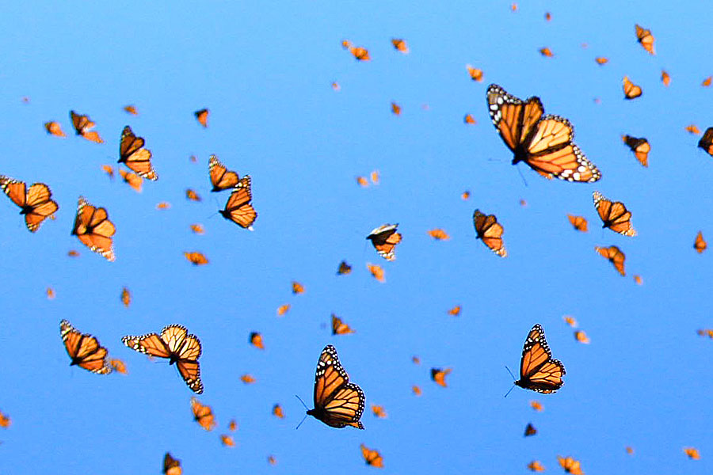
Butterfly Migration

Slide 24
Flower Petal Color

Slide 25
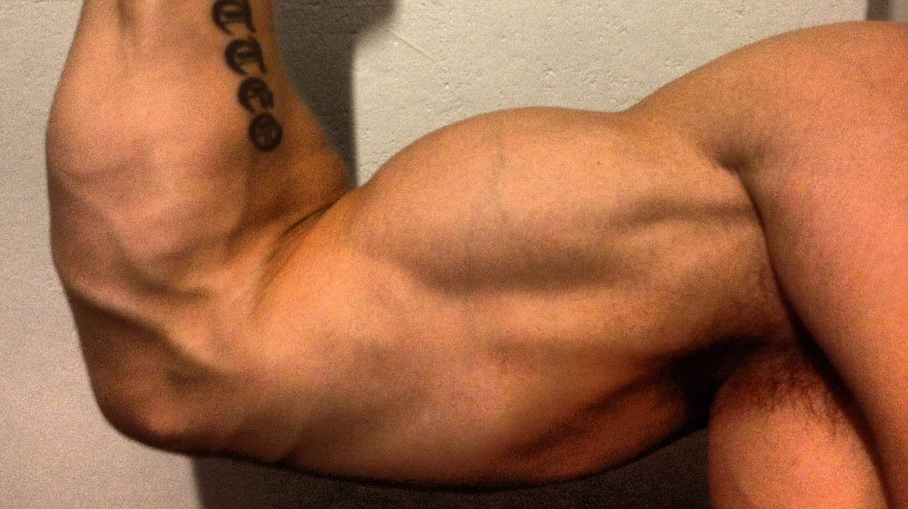
Good Muscle Tone

Slide 26
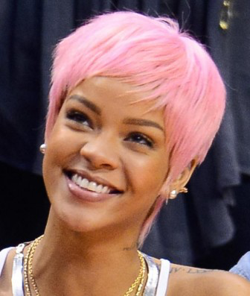
Pink Hair

Slide 27
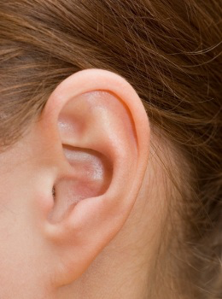
Attached Ear Lobes

Slide 28
Typing

Slide 29
Reading a Book

