Slide 1
How do Materials move in & out of the Cell?
They move across the cell membrane by:
Passive Transport (no energy required)
or
Active Transport (energy required)

Slide 2
Passive Transport
How materials move across a Cell Membrane.
NO Energy required
Materials always move from a HIGH to a LOW CONCENTRATION until equal!
Or from a more crowded area to a less crowded area to achieve a balance
(JUST RIGHT).

Slide 3
2 Types of Passive Transport
Diffusion
Osmosis

Slide 4
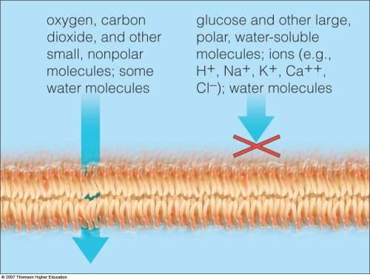
Selectively Permeable Membrane
The cell membrane controls what can enter the cell as well as what can leave the cell.
Pink & Purple
Polk-a-Dotted
Pastel Easter
Sweater
Lipid Bilayer = Cell Membrane

Slide 5
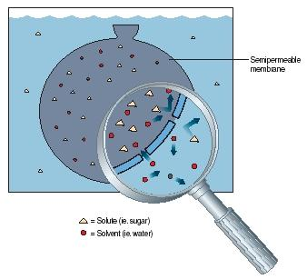
SEMI-PERMABLE MEMBRANE

Slide 6
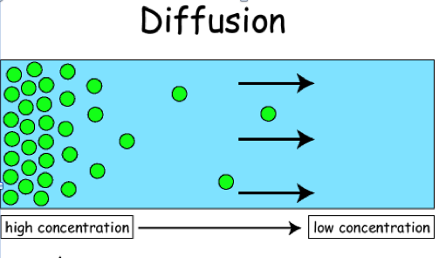
Diffusion EXAMPLE 1
The movement of material from a HIGH concentration to a LOW concentration until EQUAL.

Slide 7
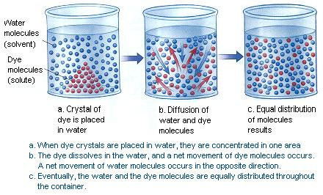
Diffusion EXAMPLE 2

Slide 8
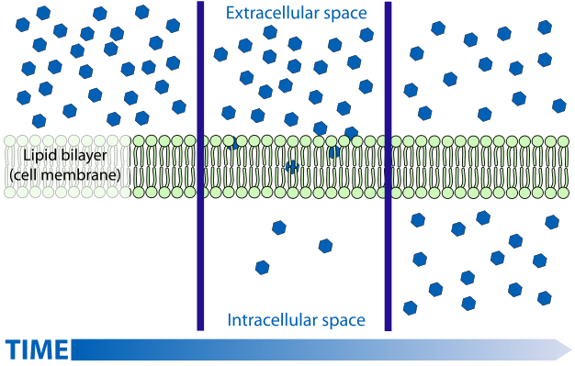
DIFFUSION EXAMPLE 3
JUST RIGHT!
High concentration or CROWDED
14 dots
Low Concentration or NOT Crowded
14 dots

Slide 9
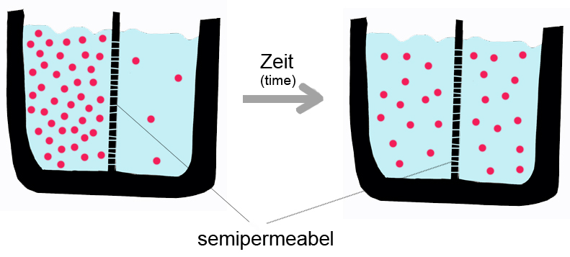
Diffusion EXAMPLE 4
JUST RIGHT

Slide 10
Osmosis EXAMPLE 1
Osmosis is the movement of Water molecules from area of HIGH Water Concentration to area of LOW Water Concentration!
Why don’t the SUGAR molecules diffuse???

Slide 11
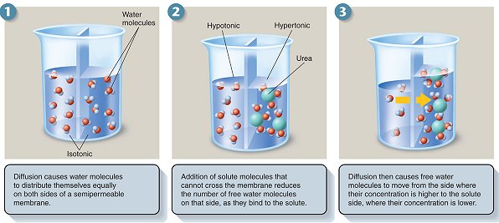
OSMOSIS EXAMPLE 2
Urea low Urea high
Water high Water low

Slide 12
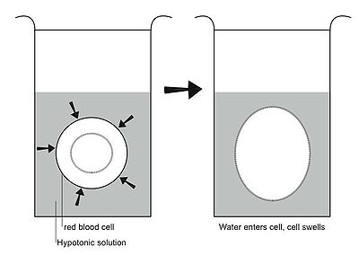
OSMOSIS EXAMPLE 3
Low Water concentration inside the blood cell!

Slide 13
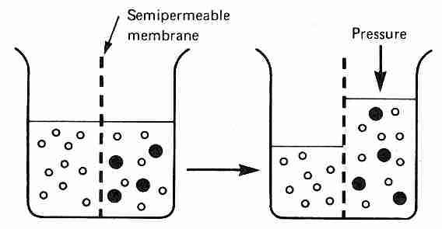
OSMOSIS EXAMPLE 4
Water molecules
Sugar molecules

Slide 14
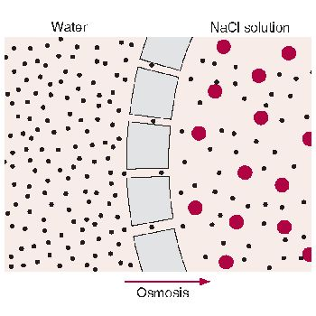
OSMOSIS Example 5
Why don’t the salt molecules (red circles) diffuse across the membrane?
SALT SUCKS!!!

Slide 15
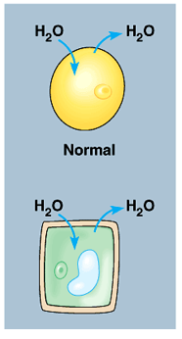
Osmosis in Plant & Animal Cells
1. What do the plant & animal cells do when equal amounts of water moves into and out of the cell?

Slide 16
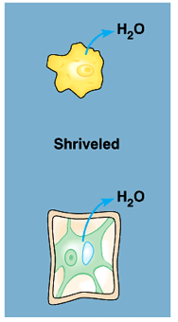
Osmosis in Plant & Animal Cells
What happens in Plant & Animal Cells when water diffuses out of the cell?
(notice the plant cell’s vacuole)

Slide 17
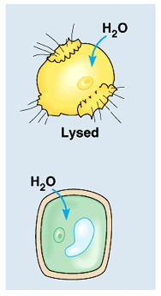
Osmosis in Plant & Animal Cells
What happens in Plant & Animal Cells when water diffuses into the cell?

Slide 18
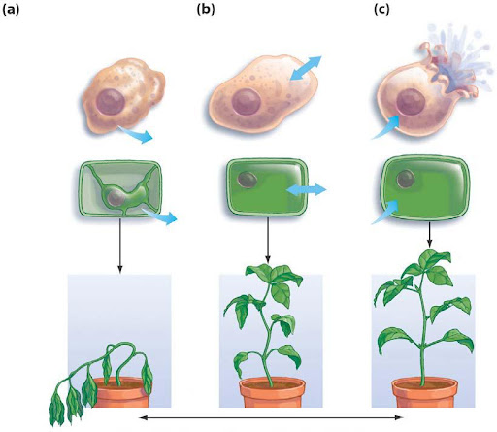
OSMOSIS
Arrows show movement of
WATER!

