Slide 1
Asexual Vs. Sexual Reproduction

Slide 2
Asexual Reproduction
Reproduction of offspring from one parent!
1 One parent passes copies of all its
genes to each offspring
2 Offspring are clones (identical) to each
other & parent
3 Easy / Fast / Uses Less Energy
4 Produces Many offspring
5 Doesn’t take much time

Slide 3
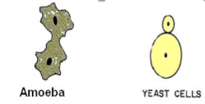
Asexual Reproduction
6 No Genetic Variety = Not a good chance
of surviving in a changing environment.
7 Single celled organisms, bacteria, fungi,
many non-flowering plants.

Slide 4
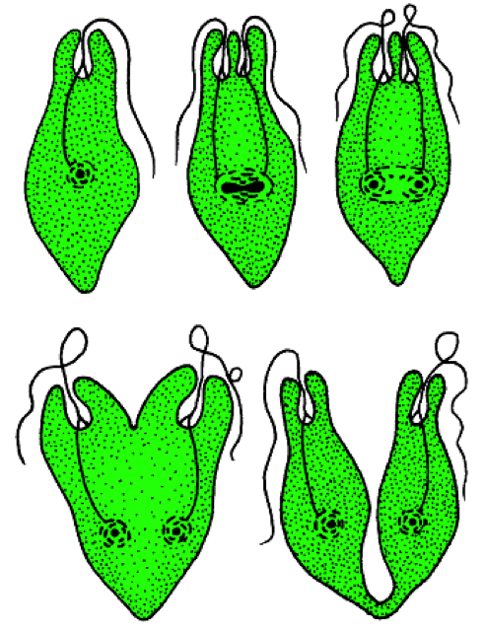
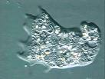
Three types of Asexual Reproduction
Fission
Cell splits in half!
Ex – amoebas & bacteria

Slide 5
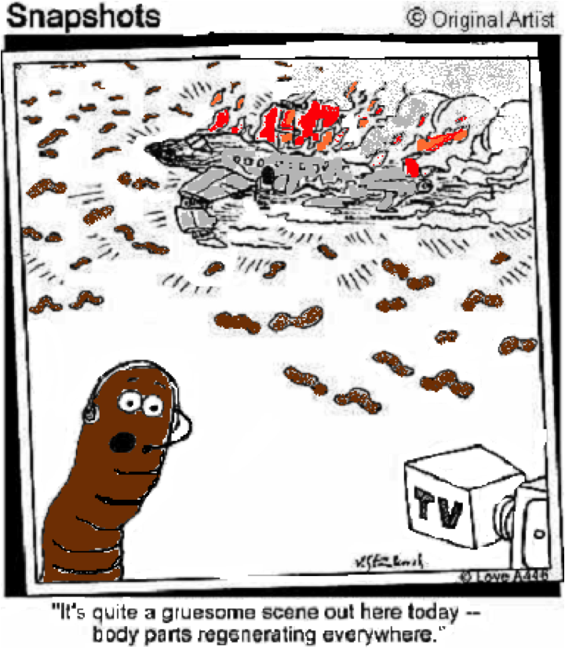
Three types of asexual reproduction
Fragmentation
The body breaks into several pieces (fragments)
Each fragment later develops into complete adults (missing parts are re-grown)
Ex: Fungi, Moss,
Sea Stars, planarians

Slide 6
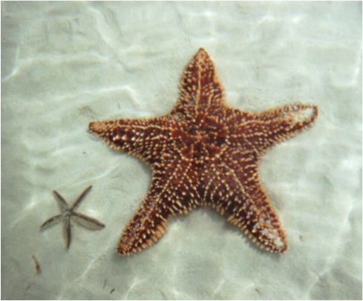
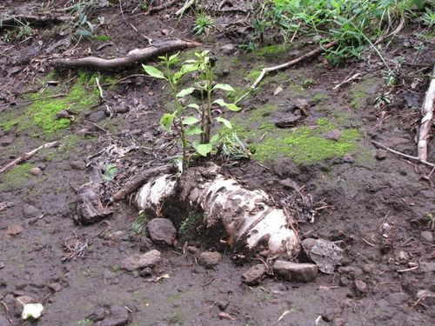
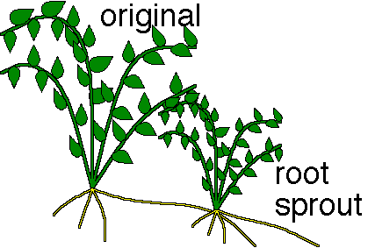
Examples of Fragmentation
Root Fragmentation
Aspen Tree Root starting shoots (new trees)

Slide 7
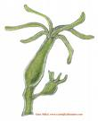
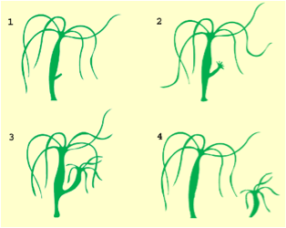
Three types of Asexual Reproduction
Budding
Offspring grows & splits off from parent.
The bud may break from the parent and become an independent organism or it may remain attached to the parent
Example – Hydra & Yeast, Clipping from a house plant

Slide 8
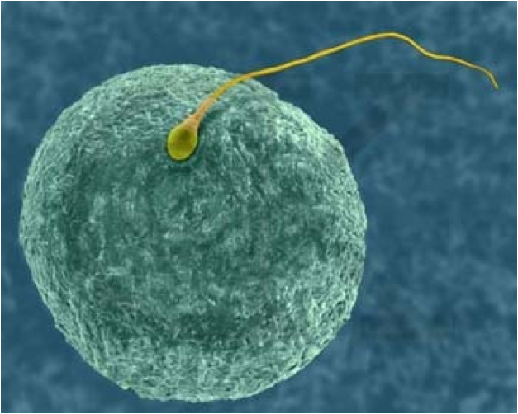
Sexual Reproduction
1 Formation of offspring from TWO
Parents!
2 The combination of an egg cell & sperm cell or (gamete cells) = Fertilization
3 Produces fewer offspring
4 Harder (More energy & time to select mate)
Sperm Cell
Egg Cell

Slide 9
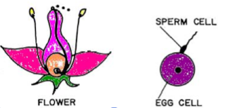
Sexual Reproduction
5 Offspring have a mixture of traits from both parents this creates Genetic Variation
6 Genetic Variation increases survival in a changing environment
7 Occurs in almost ALL flowering plants & animals

Slide 10
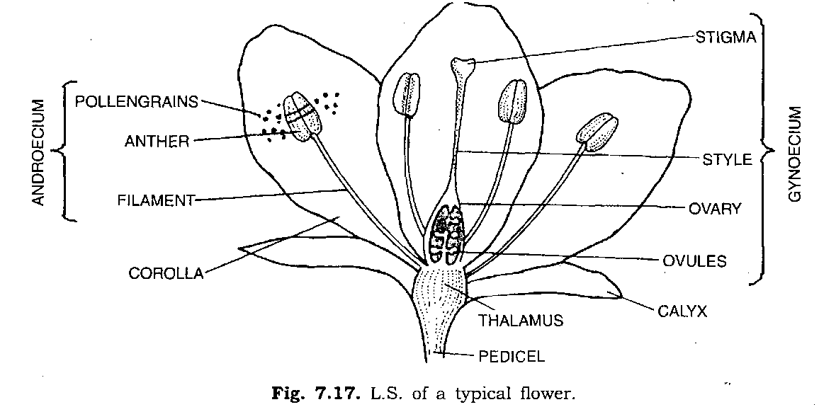
Sexual Reproduction in Plants Pollination
Flowering Plants
Plants can’t move to find mates so they use an external source for pollination (wind, bee, bat, butterfly, etc.
Pollen grains (sperm cell) is delivered to the Ovule (egg cell)

Slide 11
Sexual Reproduction in Animals

Slide 12
Comparing
 | ASEXUAL REPRODUCTION | SEXUAL REPRODUCTION
ADVANTAGE | Only one parent is needed Lots of offspring Happens quickly Fast & less Energy needed | Genetic variation More likely to survive a changing environment
DISADVANTAGE | No genetic variation (except with mutations) 2. Less likely to survive a changing environment | Takes time & Energy More than one parent needed Produces fewer offspring

